Slide 1




NEXT GEN EMPLOYABILITY PROGRAM
Creating a future-ready workforce
Team Members
College Name
Bavya R
Student Name :
Student ID :
Arunachala College Of Engineering For Women
au960221104040

Slide 2

CAPSTONE PROJECT SHOWCASE
Project Title
Car Rentals Application with Django Framework
Abstract | Problem Statement | Project Overview | Proposed Solution | Technology Used | Modelling & Results | Conclusion

Slide 3
Abstract
Car Rental System is a revolutionary application designed to streamline the car rental process offering
users a convenient and efficient way to rent vehicles. Through Car Rental System, users can easily
browse, select, and reserve cars from a disparate fleet of vehicles available at various locations.
The application integrates advanced features such as real-time availability tracking, secure payment
processing, and seamless communication between users and rental providers. With its user-friendly
interface and comprehensive functionalities, Car Rental System sets a new standard for modern
car rental services, catering to the needs of both individuals and businesses alike.
Source :

Slide 4
Problem Statement
The Manual car rental system provides services only during office hours. So customers have limited time to make any transactions or reservations of the cars. The existence of the online car rental systems nowadays has overcome the limitations of the business operation hour. Most of the systems offered reservation service for tourists or travelers. Besides that, there are some customers who faced a problem in choosing car to be rented which suitable with some of the important requirements,
1.To rent a car a prospective renter must first go to the nearest office to register as a client.
2. Cars that provide difficulties to rent out are normally advertised in local or national newspaper. It involves a lot of paperwork and consumes time.
Source :

Slide 5
Project Overview
This car rental system focuses mainly on dealing with customers and dealers. Also, the system displays all the available vehicles with their respective names, colors, addresses, etc.
This project is divided into two categories:
1.Customer Panel and
2.Dealer Panel.
A customer can simply register into the system and use it.
The customers can perform actions like searching vehicles and managing their orders.
For searching a rental vehicle, he/she should enter a city name.
A vehicle’s rent is calculated according to the number of seat capacity and rental days.
A customer can simply select a car from the search result and confirm the rental order.
The confirmation order displays the car’s name with dealer information and much more.
As soon as, he/she confirms the order, the user can view all his/her orders in the order list.
Source :

Slide 6
Proposed Solution
The Solution to the problem is , Online Car Rental System, the users will able for searching and reserving their favorite cars easily through the Internet and it can be accessed at anytime. Hence, the company is able to improve their customer satisfaction level, increasing efficiency by providing better services to their customers
ACTORS:
● Customer
● Administrator
FUNCTIONAL REQUIREMENTS:
● User Registration: Allow users to register an account with their personal information, contact
details and payment methods.
● Vehicle Availability: Provide a mechanism for users to search and check the availability of vehicles based on location, date, and time.
Source :

Slide 7
● Vehicle Booking: Allow users to select a vehicle, specify the rental period, and make a reservation.
● Reservation Management: Enable users to view, modify, and cancel their reservations.
● Online Payment: Integrate a secure payment gateway to facilitate online payment for vehicle rentals.
● Vehicle Pick-up and Return: Provide a process for users to pick up the reserved vehicle at the designated location and return it at the end of the rental period.
● Vehicle Inspection: Include a vehicle inspection process to assess and record the condition of the vehicle before and after the rental.
● Customer Feedback: Allow users to provide feedback and ratings for the rented vehicles and overall experience.
NON-FUNCTIONAL REQUIREMENTS:
● Performance: Response times for user actions such as searching, booking, and payment should be within an acceptable range.
Source :

Slide 8
● Security: Implement strong security measures to protect user information and payment transactions.
● Usability: Provide clear instructions and guidance throughout the rental process.
● Reliability: Ensure the system is available and accessible 24/7 to accommodate user bookings.
● Scalability: Design the system to handle an increasing number of vehicles, users, and transactions as the business grow and should meet requirements when time peak periods.
● Availability: Maintain high system availability with minimal planned or unplanned downtime to avoid disruptions in service.
Source :

Slide 9


Technology Used
Front-end
Back-end
Source :

Slide 10
Modelling & Results
Car Dealer Panel : A dealer can simply check his/her earnings history, orders, and vehicle list. In order to post a vehicle, the user should provide the vehicle name, color, address, seat capacity, etc. As soon as a customer confirms an order, the dealer earns the total rental amount from it.
User Interface (UI): Design an intuitive interface for users to search for available cars, view details, and make bookings.
Database: Develop a database to store information about cars, users, bookings, payments, and availability.
Authentication and Authorization: Implement user authentication to ensure secure access to the application. Authorization controls what actions each user can perform.
Booking System: Allow users to select rental dates, choose cars, and confirm bookings. Handle conflicts in case of overlapping bookings.
Payment Integration: Integrate payment gateways for secure transactions. Allow users to pay for bookings online.
Admin Panel: Build an administrative dashboard to manage users, cars, bookings, and payments. Admins should have the ability to resolve disputes and view reports.
Source :

Slide 11
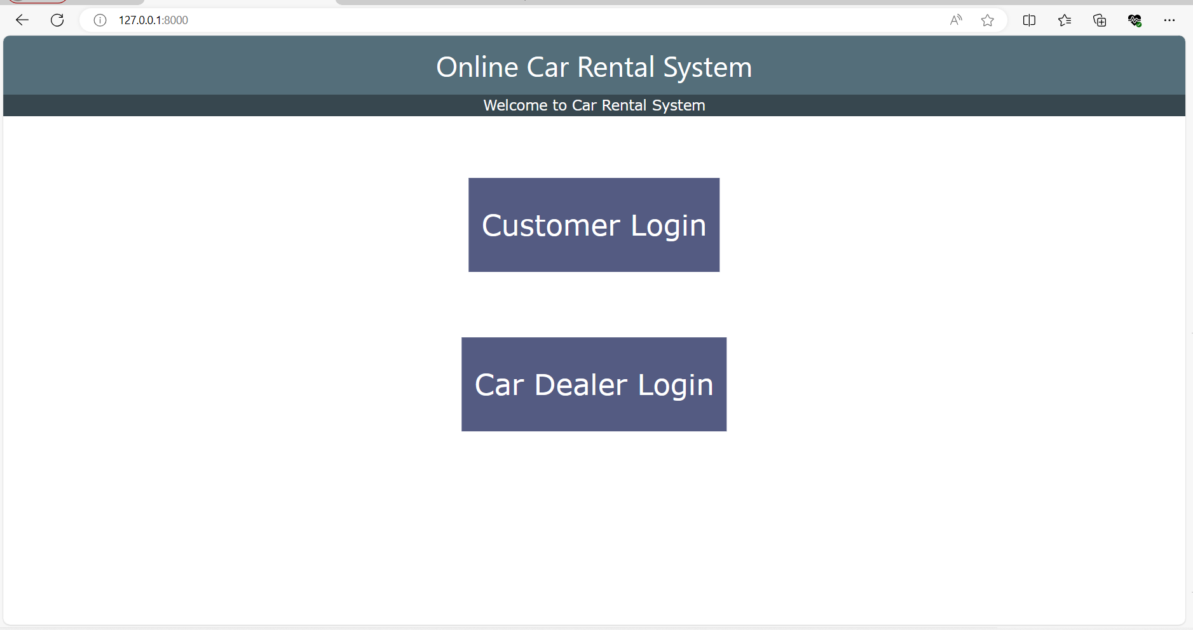
Homepage

Slide 12
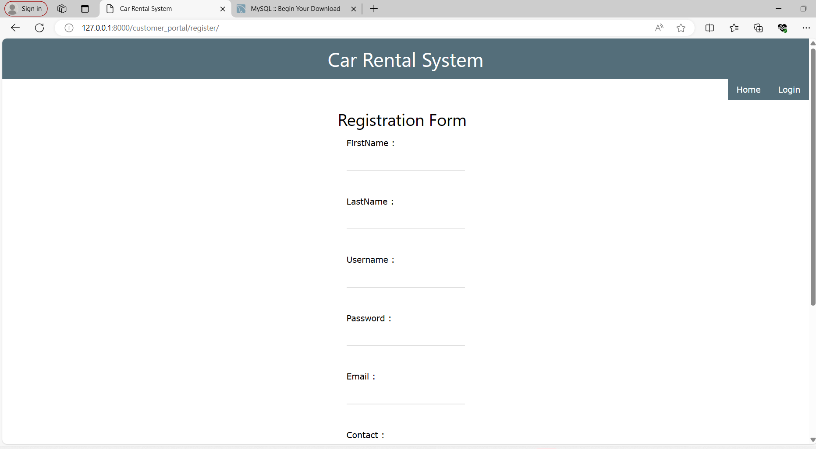
Car dealer Login Registration Form page

Slide 13
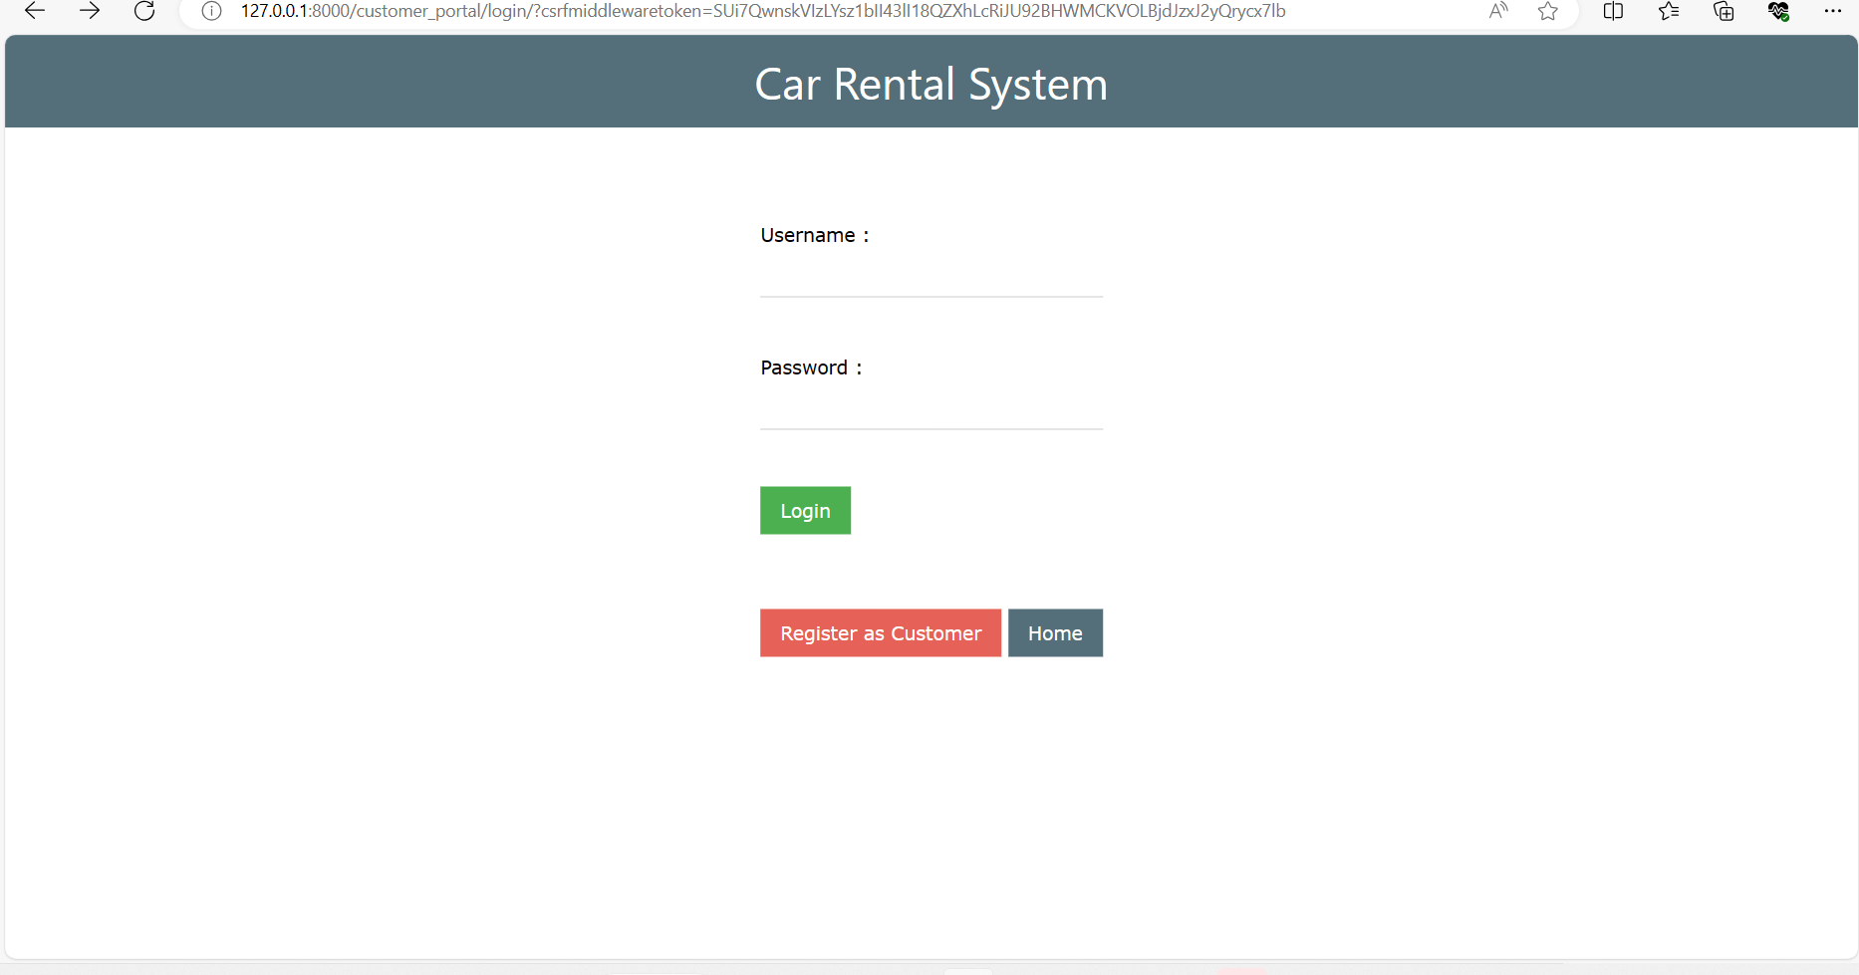
Customer Login Page

Slide 14
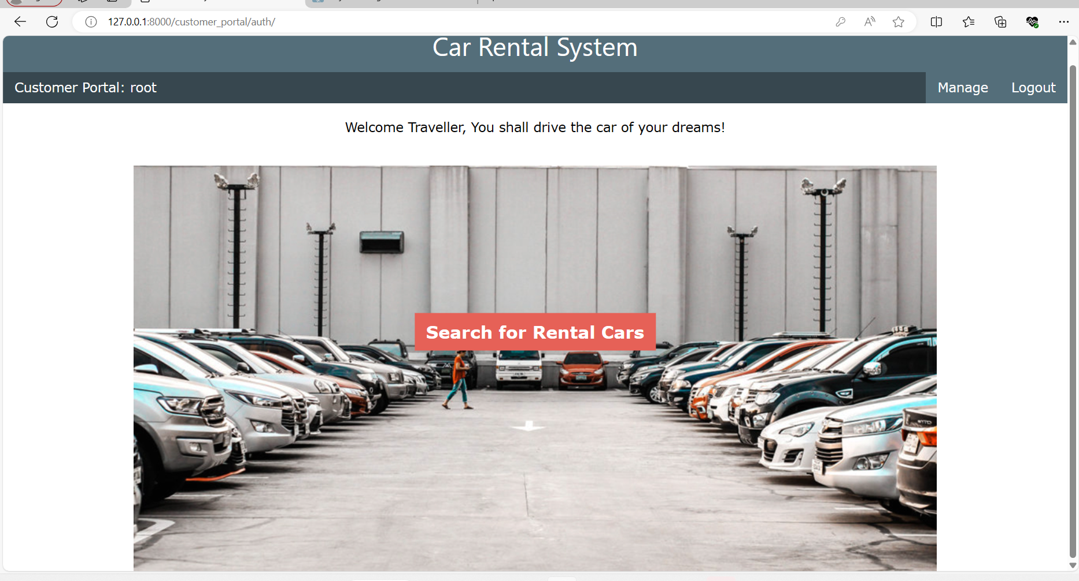
Rental Cars Search Page

Slide 15
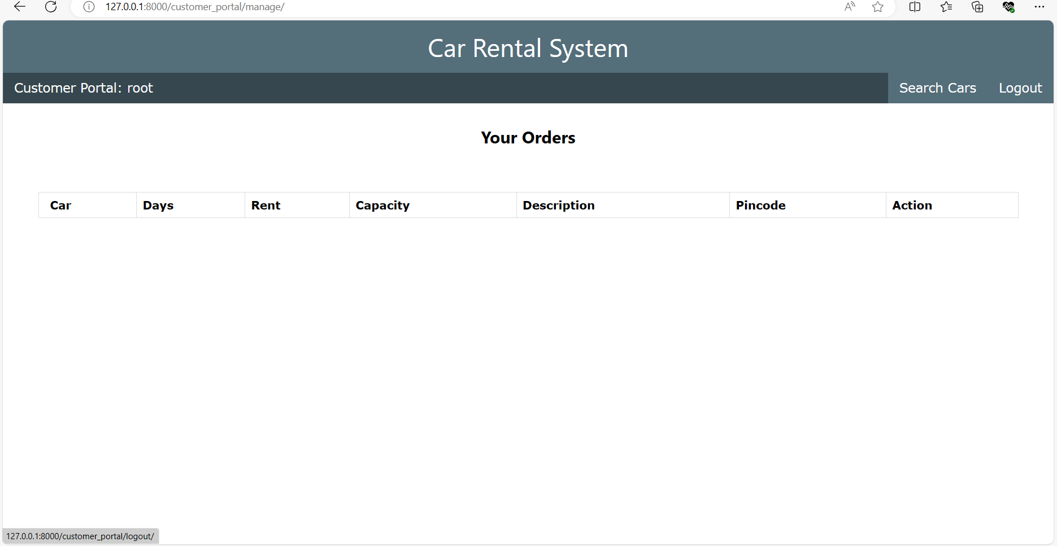
Ordered Details in Manage Page

Slide 16
Future Enhancements: 1.Peer-to-Peer Rentals: Exploring the possibility of incorporating peer-to-peer rental options, allowing individuals to rent out their own vehicles through the platform. 2.Subscription Models: Introducing subscription-based rental plans, where users pay a monthly fee for access to a certain number of rental days or miles. 3.Expanded Insurance Options: Offering a variety of insurance options tailored to different user needs, including coverage for ride-sharing and long-term rentals. 4.International Expansion: Expanding into new markets and offering multi-language support to cater to a diverse customer base. 5. Personalization: Utilizing machine learning algorithms to personalize recommendations for users based on their past rental history and preferences.

Slide 17

Conclusion
The car rental application offers a convenient and efficient solution for users to access transportation services. With its user-friendly interface, diverse vehicle options, secure payment system, and seamless booking process, it enhances the overall experience of renting a car. Overall, the car rental application is poised to revolutionize the way people access rental vehicles, making it a valuable asset in today's fast-paced world.
Source :

Slide 18
Thank You!
Notes:
Thank You !!

